Slide 1
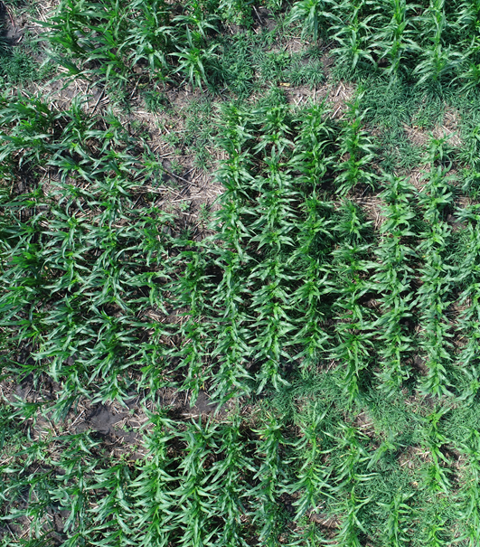
Crop Identification and Segmentation Through Image Analysis
Nicolaas VanSteenbergen
University of Nebraska at Omaha
research conducted with:
Xiaoyue Cheng PhD, UN-Omaha
Jinliang Yang PhD, UN-Lincoln

Slide 2
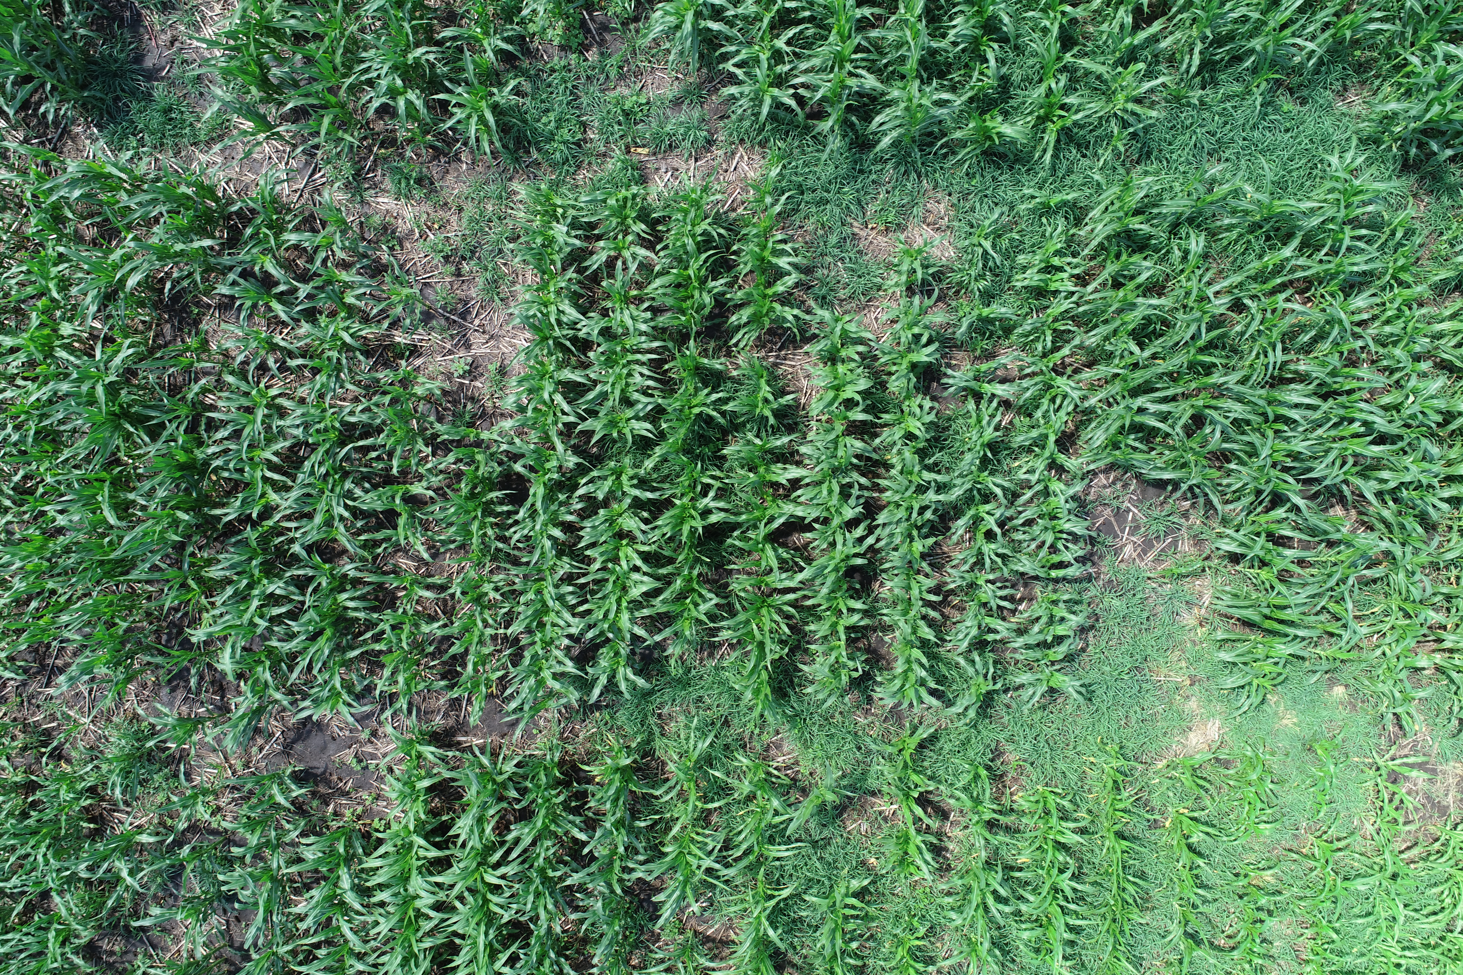
Motivation
Planting an entire field of crops is very expensive, so agriculturalists need to be they make the correct decision.
Tracking and diagnosing different genotypes of crops in a test field will give the information needed to make that decision.
The goal is to identify and segment individual crop rows throughout multiple images.

Slide 3
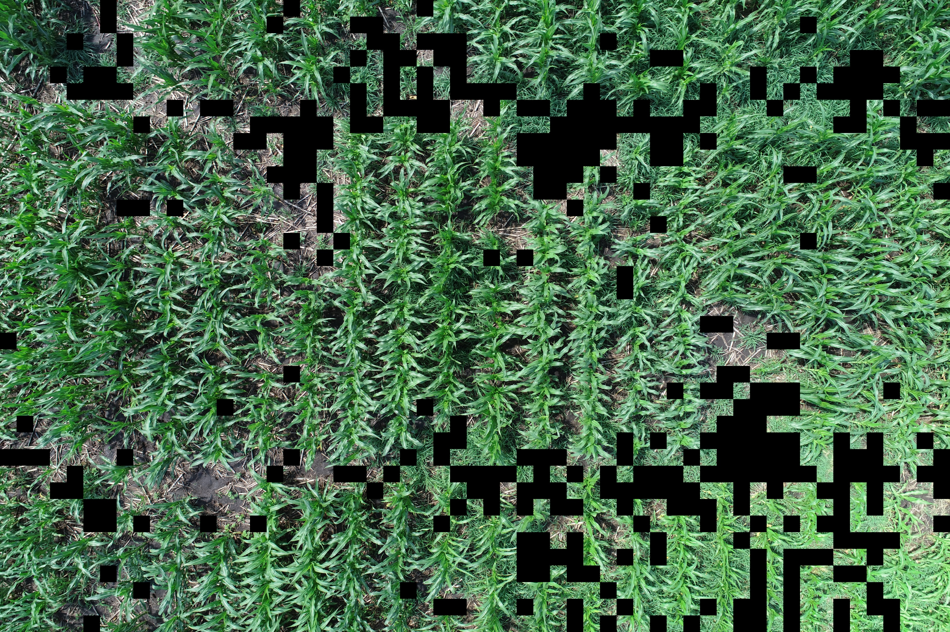
Deep Learning to Identify Weeds
Simple InceptionV3 model using ~600 images to help classify: weeds, soil, or crops. Still tuning the model and collecting more data to improve its classification rate. (96x96 boxes)

Slide 4
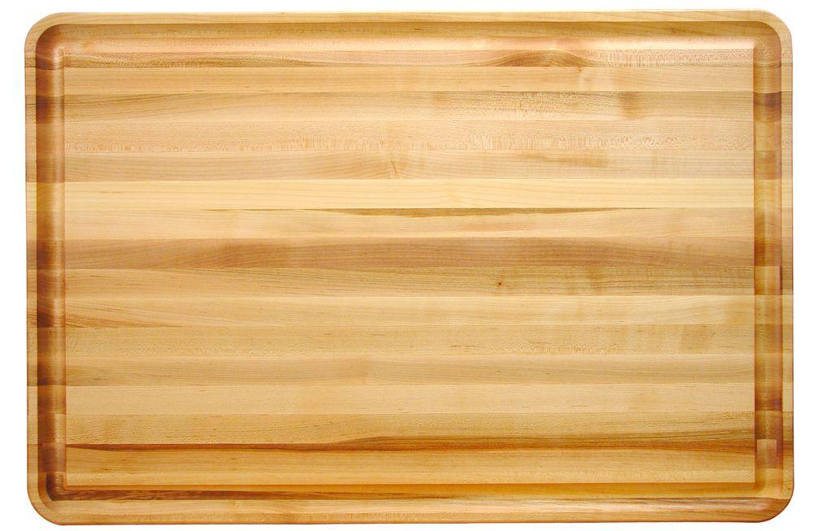
Image Preparation

Slide 5
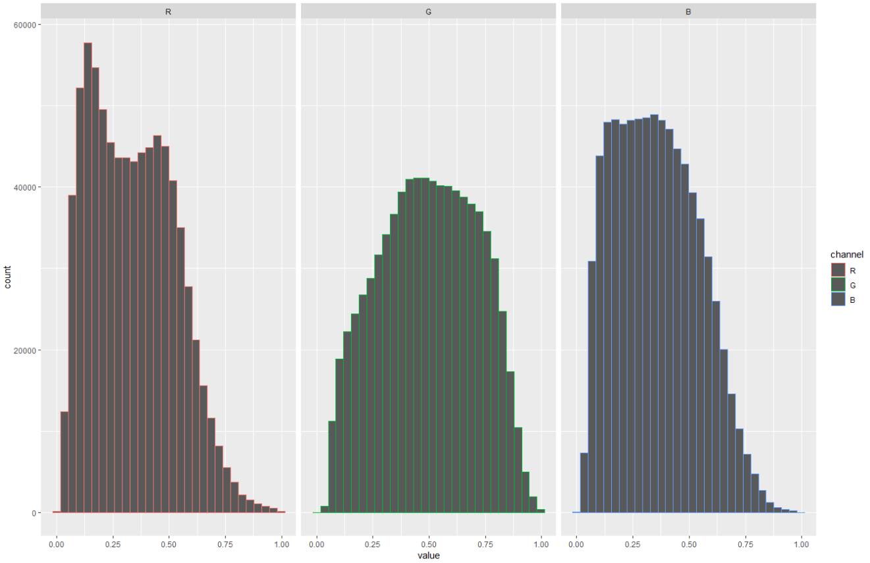
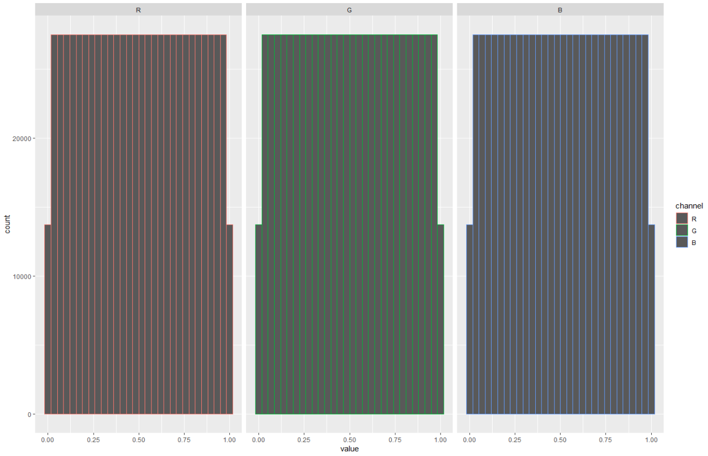
Histogram Equalization
Breaks the image into its separate RGB channels and equalizes each one separately. Now the intensity of each RGB channel is more uniform, the image has higher contrast. (using the ECDF to make each channel uniform)

Slide 6
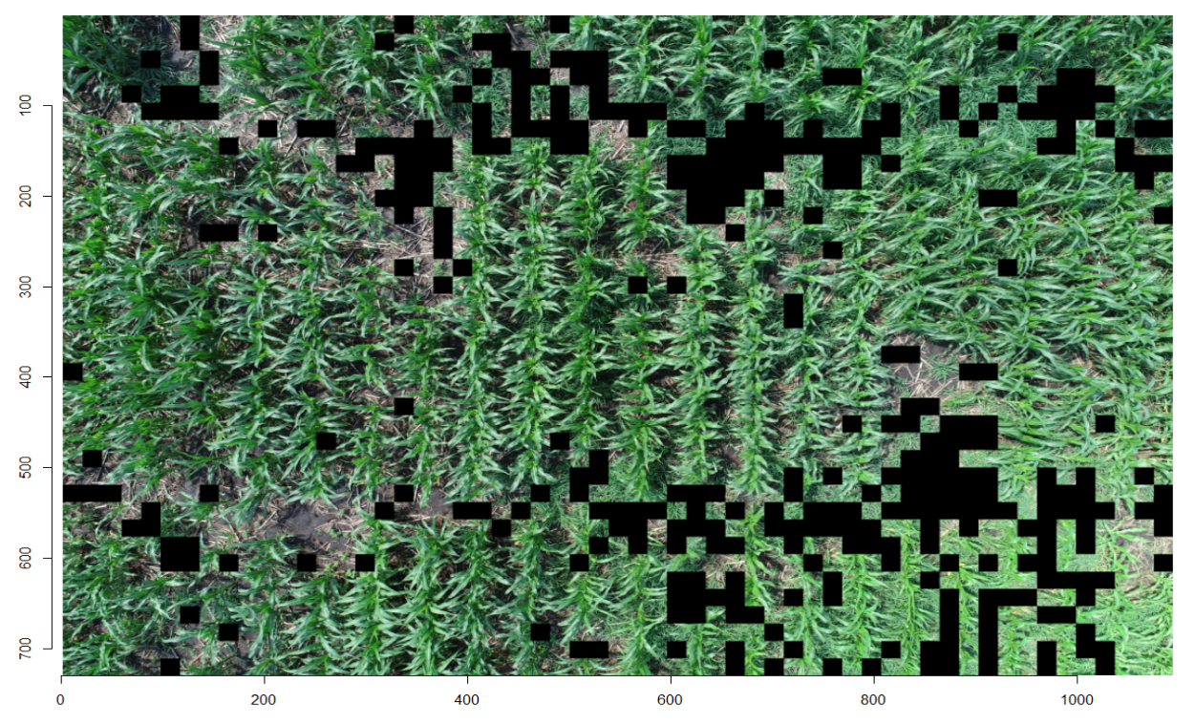
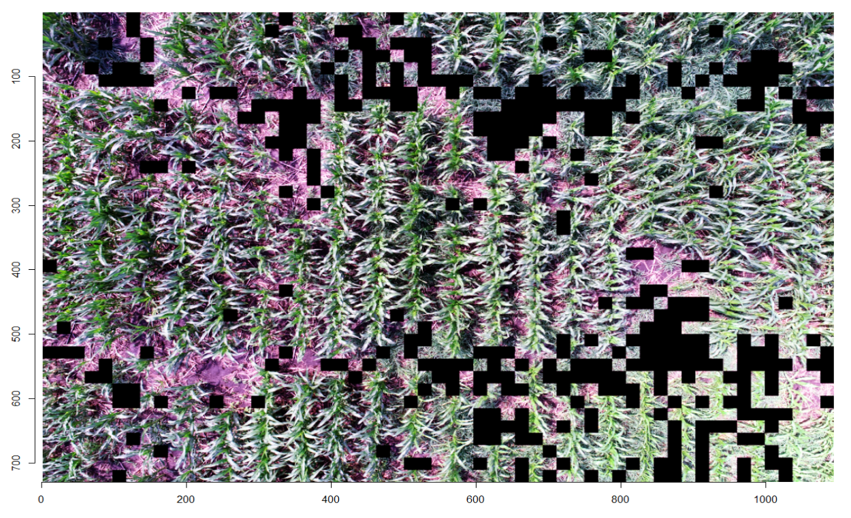
Equalized Image

Slide 7
Excess Green Index
Before the ExG is performed the images are scaled down to 20% their original size. This helps with performance issues as well as reduce noise since there is some information loss in the process.
Identifies specific hue of green in the crops. There are many different variations of this index but we use ExG = 2g – r – b, where r,b,g are normalized version of the original RGB. (r = (R / (R+G+B)))
Becomes a grayscale image where its intensity is based on the ExG values.
D. Woebbecke, G. Meyer, K. Von Bargen, D. Mortensen Shape features for identifying young weeds using image analysis Trans Am Soc Agric Eng, 38 (1995), pp. 271-281

Slide 8
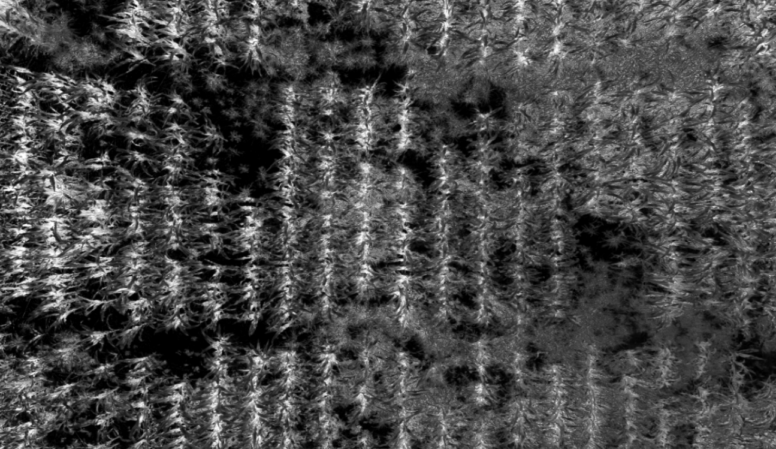
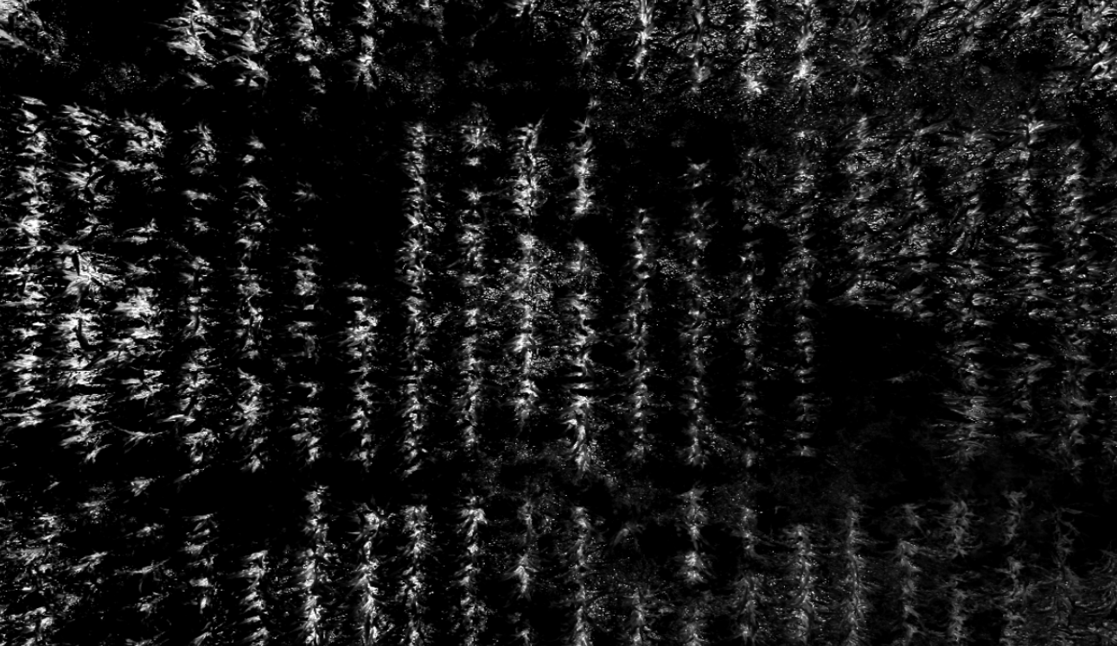
Not Equalized vs. Equalized
Less diversity of intensities in the equalized greenness image.
* Less diverse since equalizing all channels made less true green colors

Slide 9
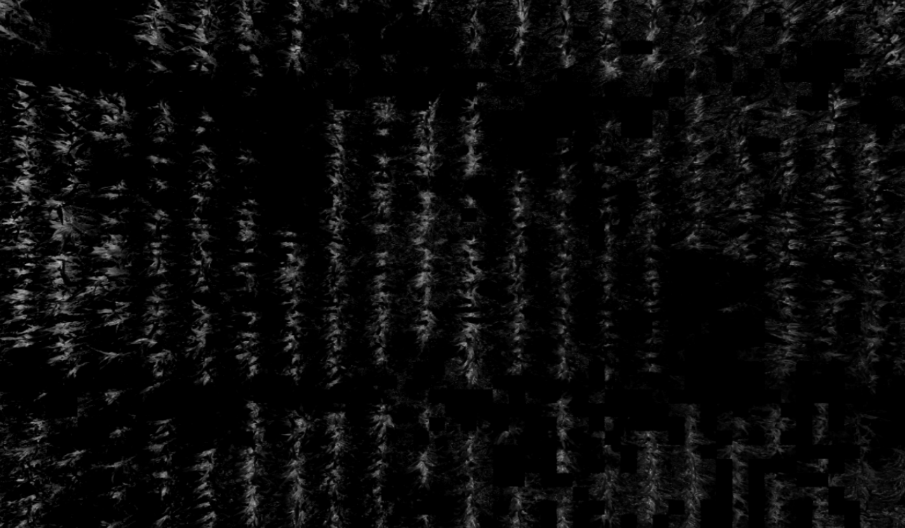
Equalized vs. Equalized Deep Learning
* The Deep Learning image is a little misleading due the plotting visuals in R. There is still noise in the image, it is just very dull. We will see this when doing the Otsu transformation.

Slide 10
Otsu Thresholding
Otsu’s method selects the threshold by minimizing the within-class variance of the two groups (background/foreground).
Otsu’s method is exhaustive so every threshold is considered. Luckily, there are limited possibilities so the process is fast.
Our ideal foreground is the crops and leaves, while the background is everything else. So we are left with a binary image that is very easy and efficient to do further modifications.
N. Otsu, "A Threshold Selection Method from Gray-Level Histograms," in IEEE Transactions on Systems, Man, and Cybernetics, vol. 9, no. 1, pp. 62-66, Jan. 1979.

Slide 11
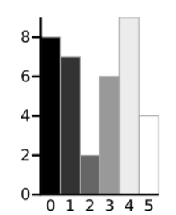
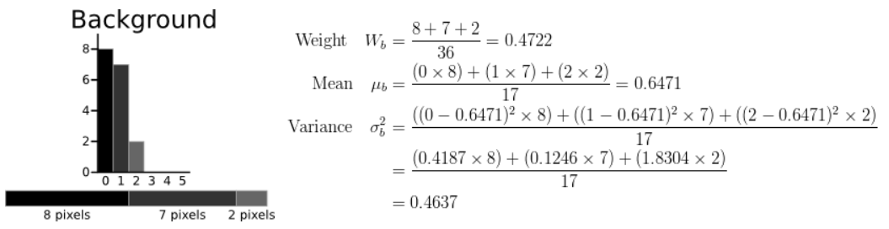
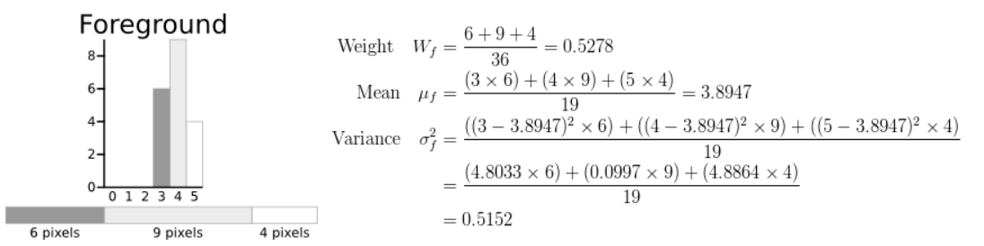
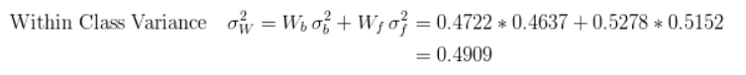
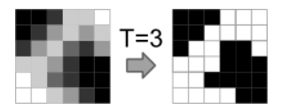
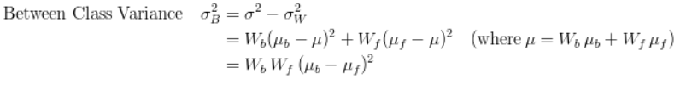
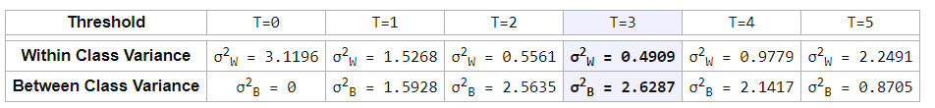
Otsu Overview
http://www.labbookpages.co.uk/software/imgProc/otsuThreshold.html

Slide 12
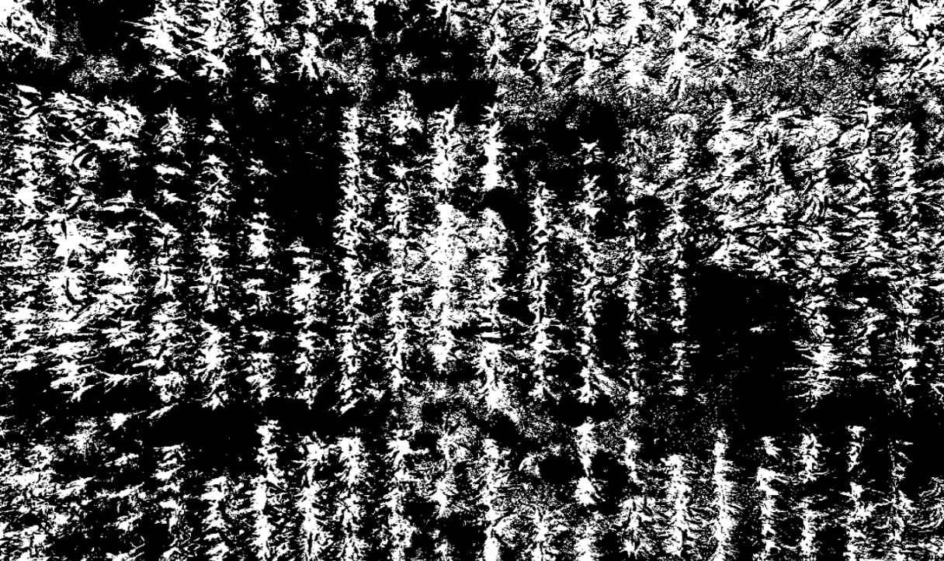
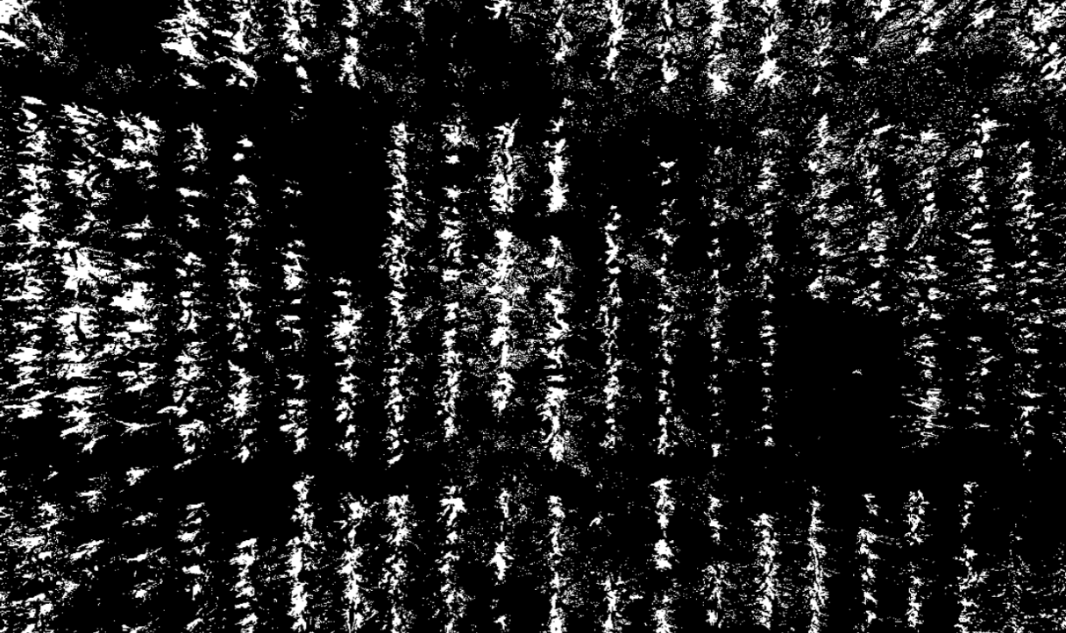
Otsu original image vs. Equalized image
The equalization process helped tremendously with the reduction of noise. This helps separate each crop rows from its neighbor.

Slide 13
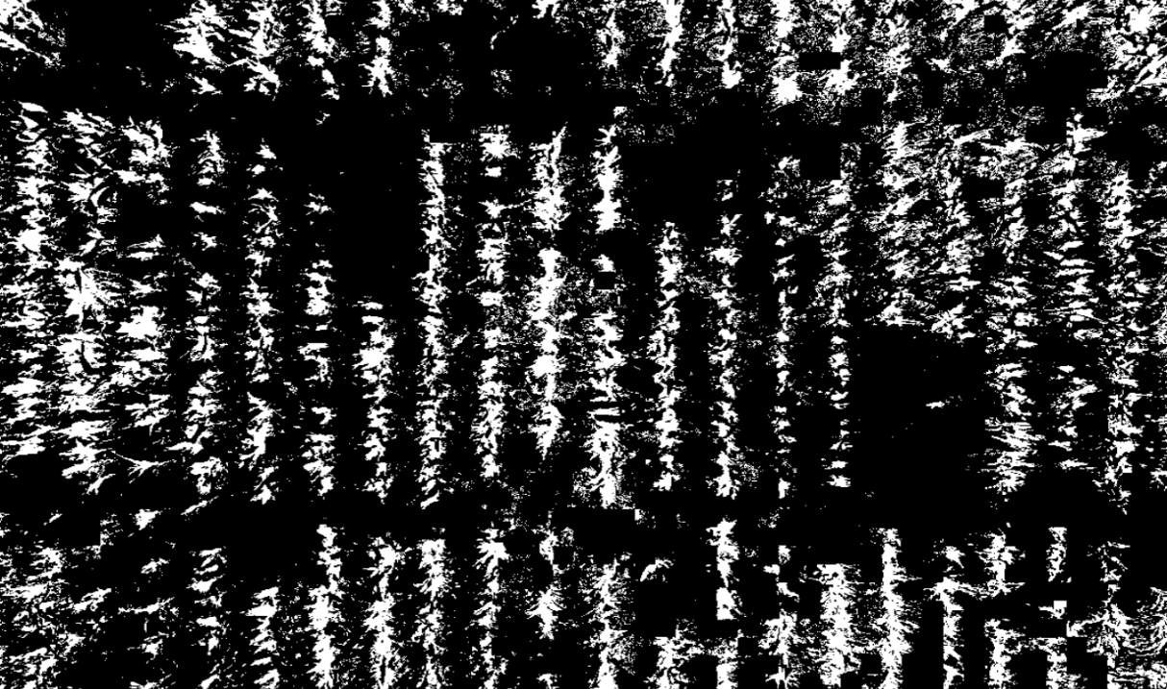
Equalized vs. Equalized Deep Learning
Deep Learning has less noise and fuller crop rows, this will help identify authentic crop rows.

Slide 14
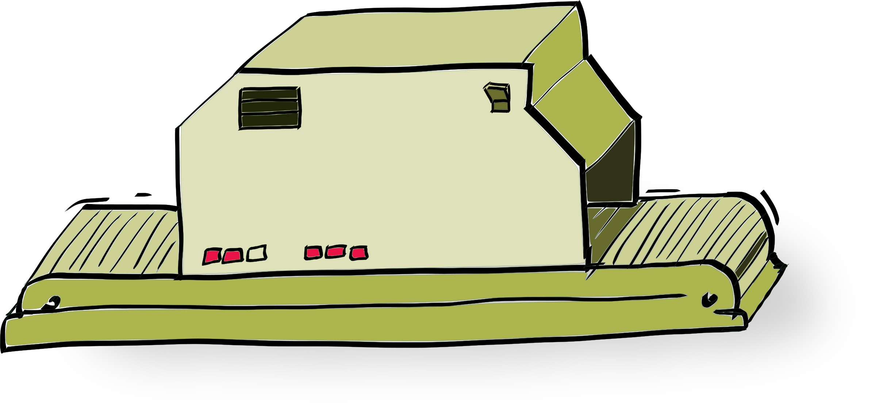

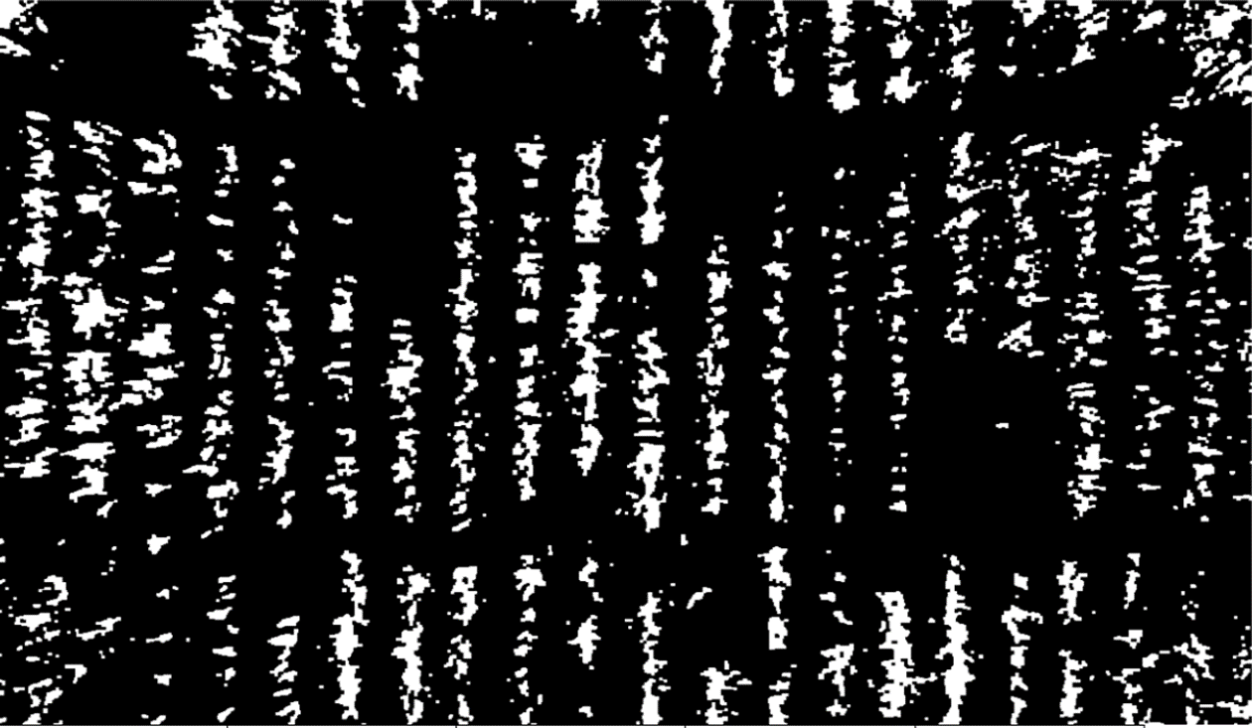
Morphology (Blobification)

Slide 15
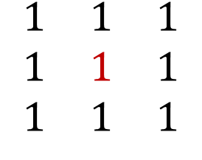
Morphology: Kernel
Kernel or Structuring Element: A matrix that will be used in the transforming of our images.
Our matrix is a 3x3 square with the origin at the center. The origin will always reside on a white (1 value) pixel when doing the transformations. There are 3 scenarios we can have:
the kernel fits completely in the white space
exists in both black and white space
is not in the white space
$$\begin{matrix}1 & 1 & 1 \\ 1 & 1 & 1 \\ 1 & 1 & 1\end{matrix}$$

Slide 16
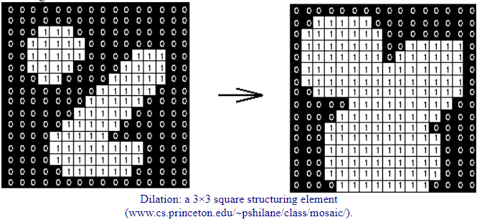
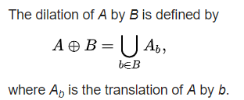
Dilation
Dilation: The morphological method to ‘fatten up’ the structures in the image and fill in gaps.
The kernel is superimposed over each valid pixel of the original structure.

Slide 17
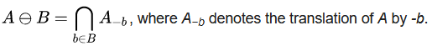
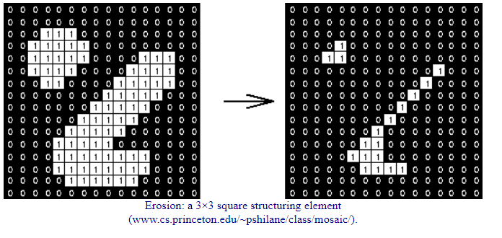
Erosion
Erosion: The morphological method to thin out or erode the image structures.
If the structuring element is not completely contained then all is 0, if it is then only the origin is kept while the rest is deleted (eroded).

Slide 18
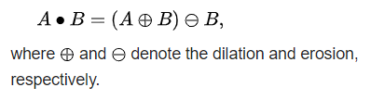
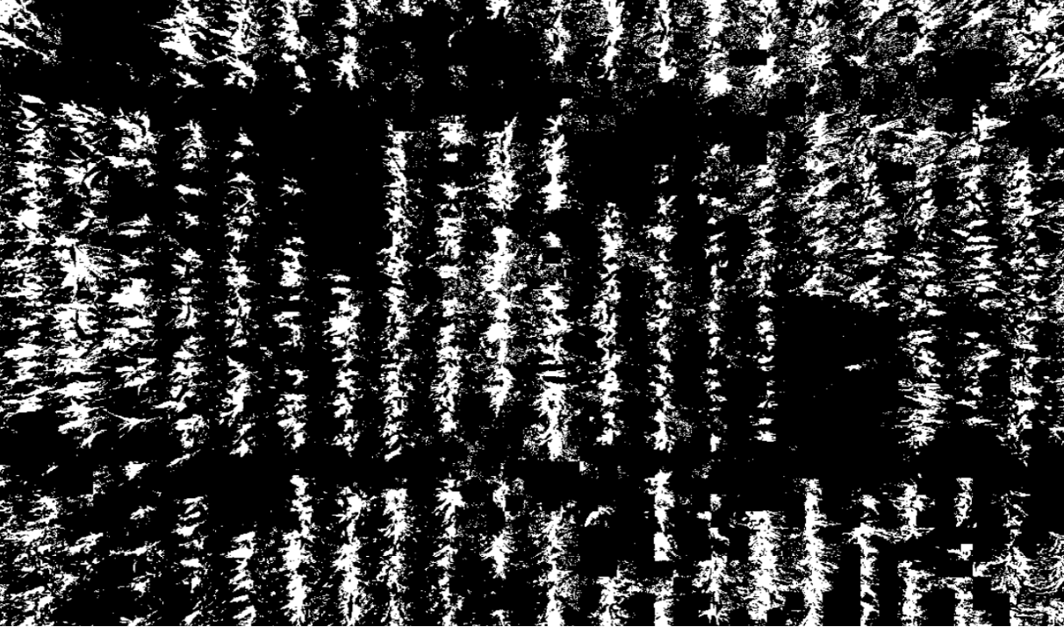
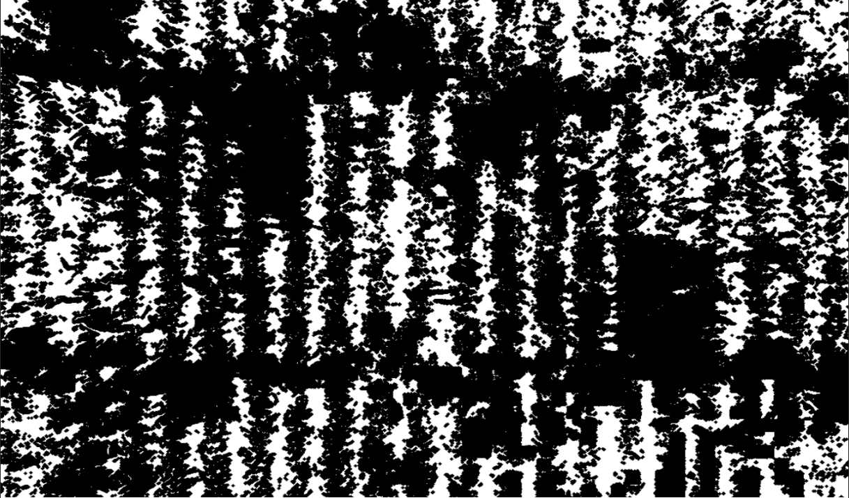
Closing
dilation then erosion
fills in gaps and clumps together random noise

Slide 19
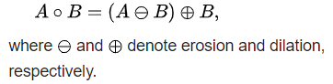

Opening
erosion then dilation
opens gaps and eliminates needless noise

Slide 20

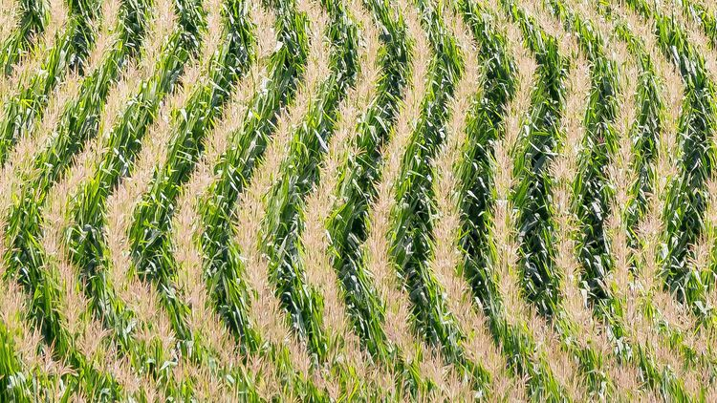
Finding Crop Row Segments

Slide 21

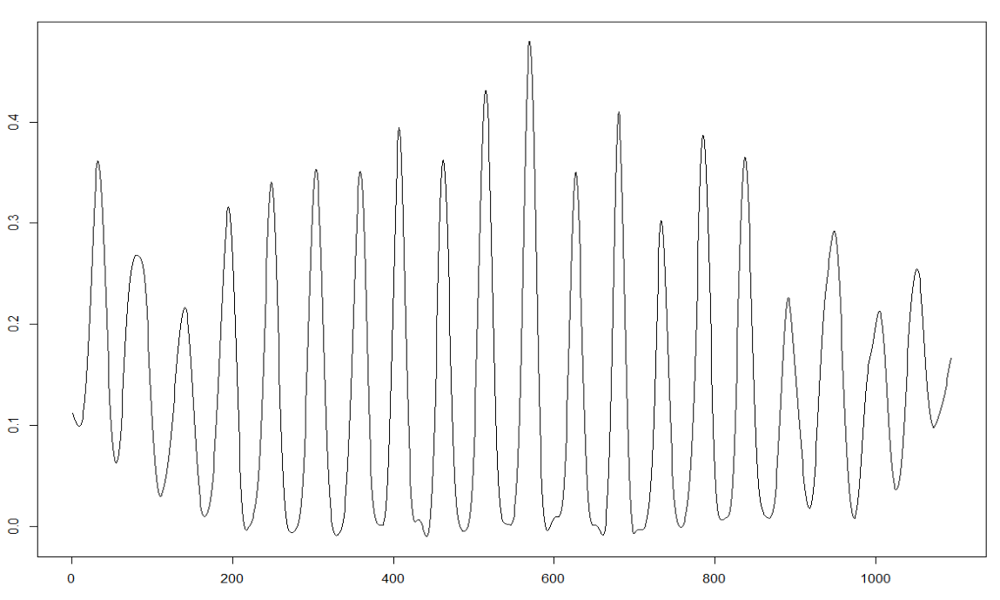
Blobs as Lines
% of row that is a crop
x column

Slide 22
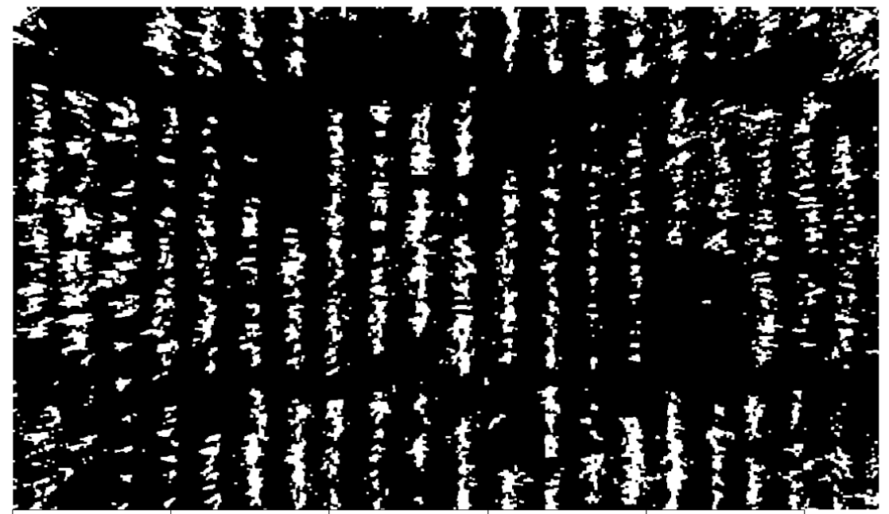
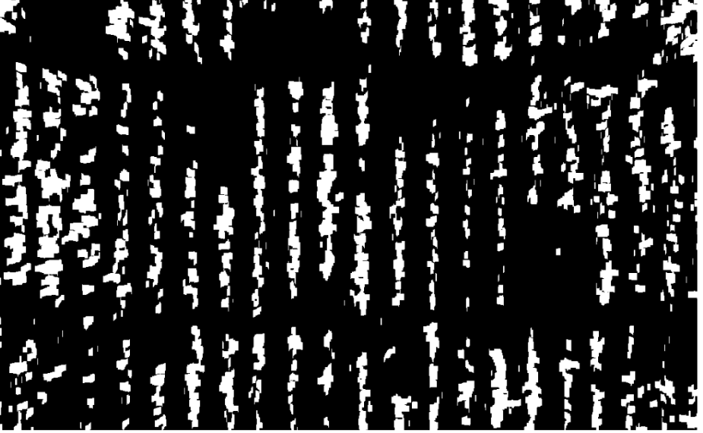

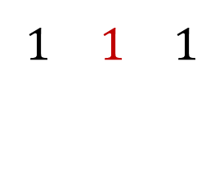
Plushen
$$\begin{matrix} & & \\ 1 & 1 & 1 \\ & & \end{matrix}$$
Erosion using the horizontal
Dilate using vertical
Careful to not overextend, making artificially long crop segments.
$$\begin{matrix} & 1 & \\ & 1 & \\ & 1 & \end{matrix}$$

Slide 23
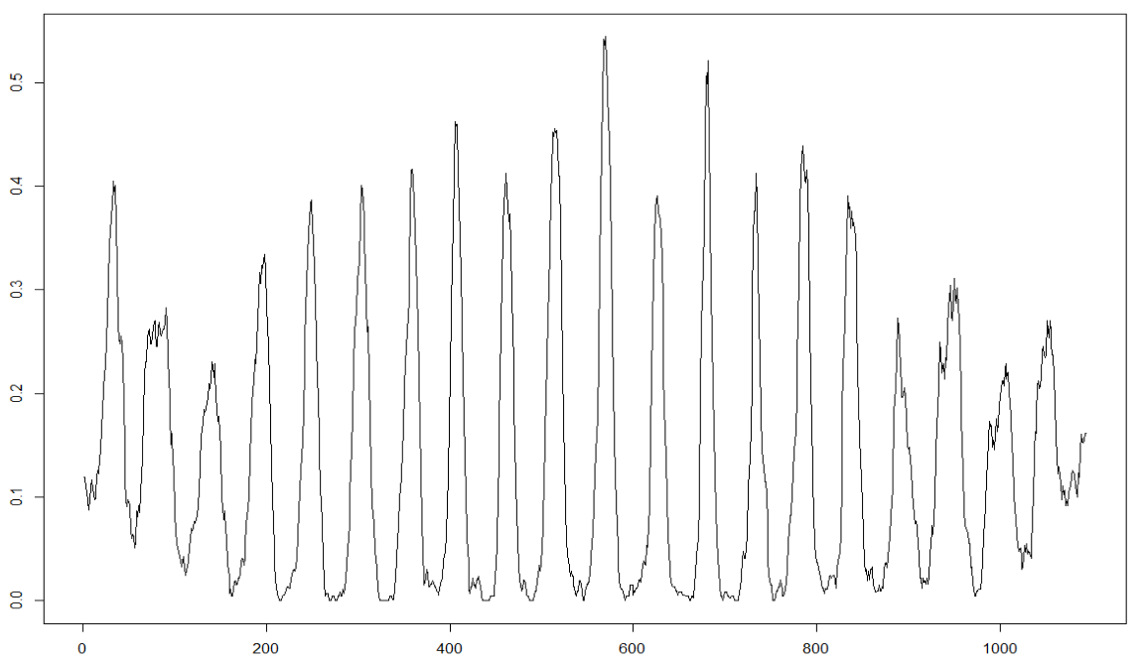
How to get the crop lines
The morphed image will now have a smooth spline applied to produce a cleaner result for further computations.
Our smoothing intensity is as minimal as possible to not change the image too drastically.

Slide 24
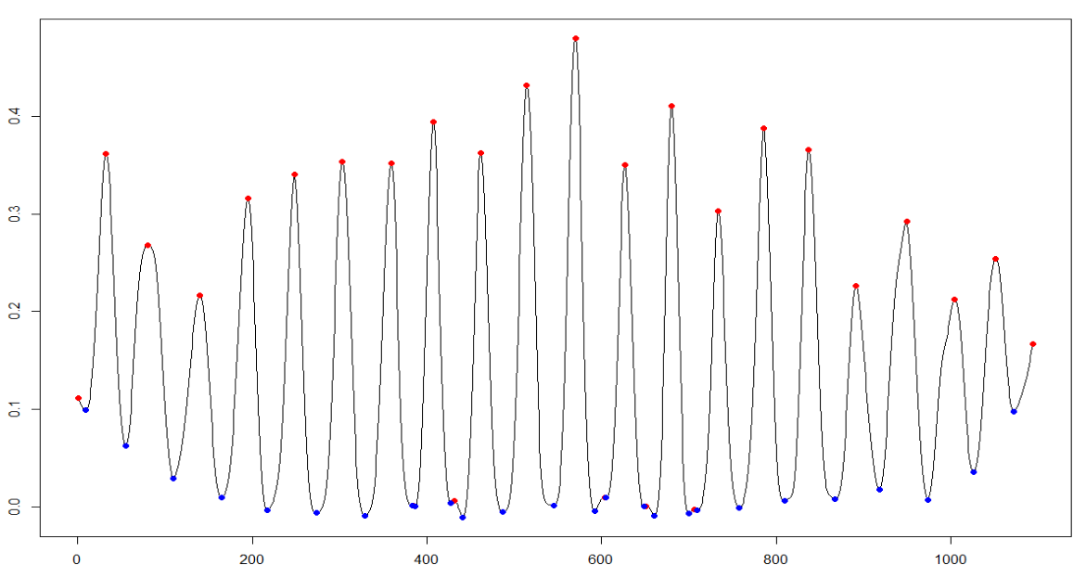
Finding the Peaks & Valleys
Using basic local max and local minimum locators, we essentially found the crop centers and the gaps in-between.
Now we need to only select the true peaks and ignore the false ones in the valleys.
These false peaks are created by random noise between crop rows
% of white pixels in the column
Column of image

Slide 25
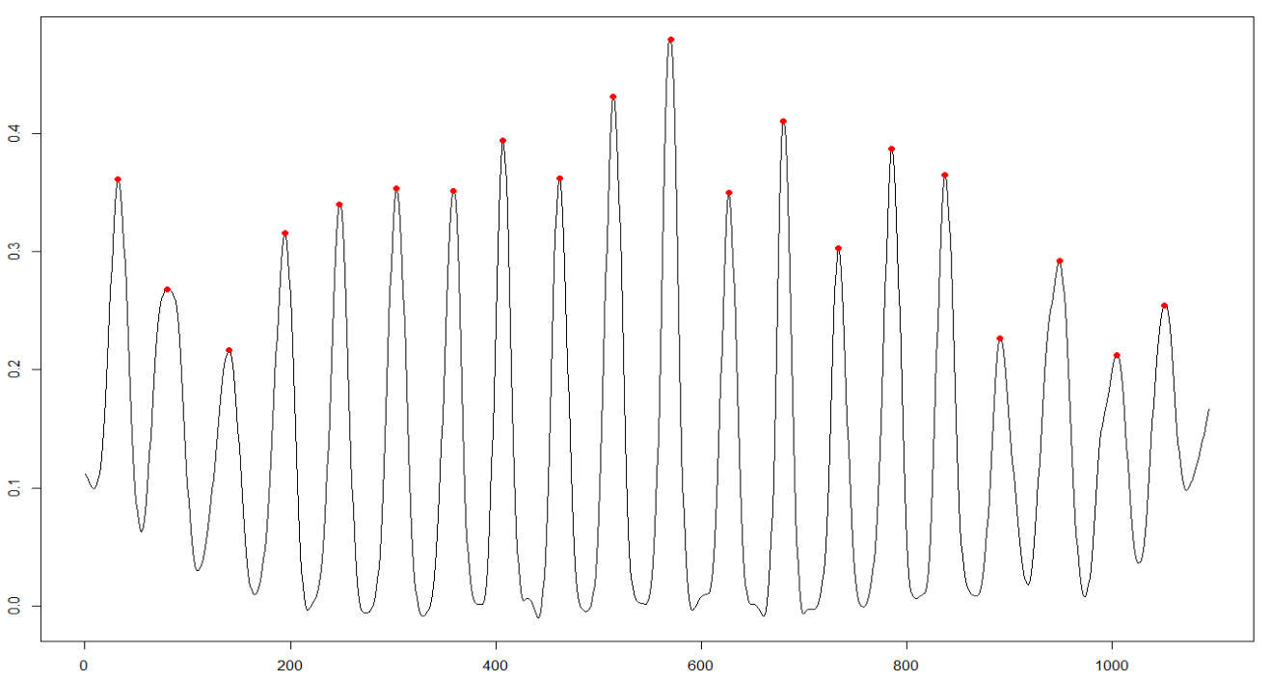
Finding Authentic Crop Rows
For each peak look at the ratio between its left and right valley.
If this ratio is acceptable, then it is deemed an authentic crop row.
Ratios are the absolute value of (peak – valley) / (max value of image)
The acceptable ratios are just the centers of each crop row

Slide 26
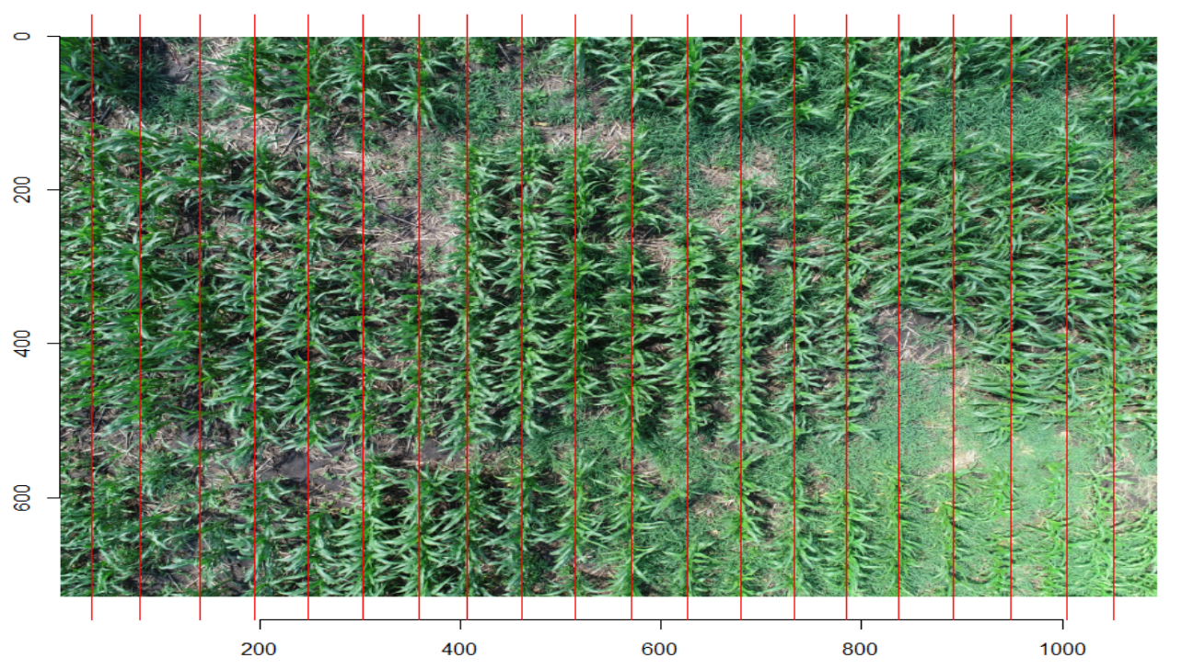
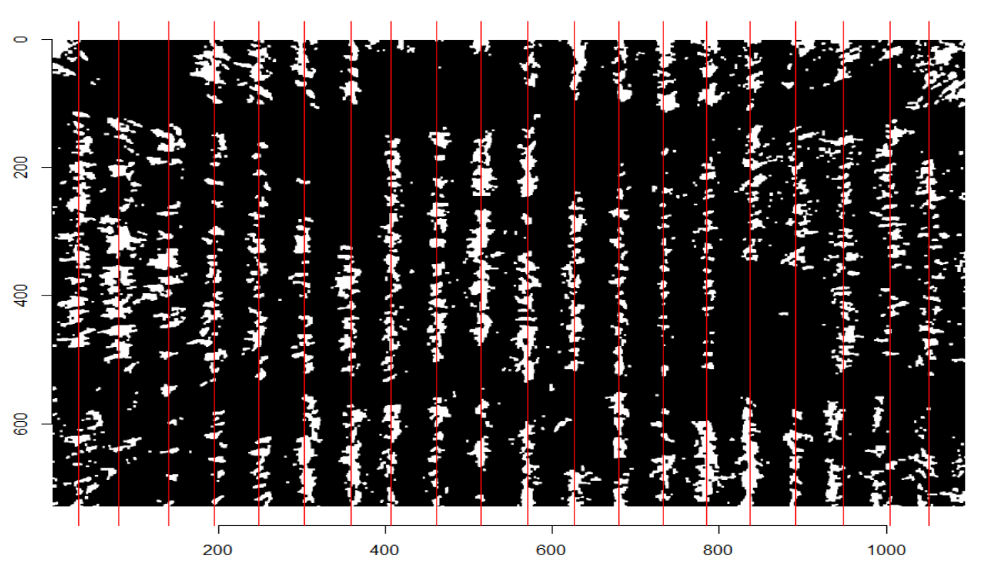
* If the crop rows are not aligned, the more defined row portion will outweigh the other. This can be fixed by chopping up the image into smaller portions and drawing individual lines for each crop segment

Slide 27
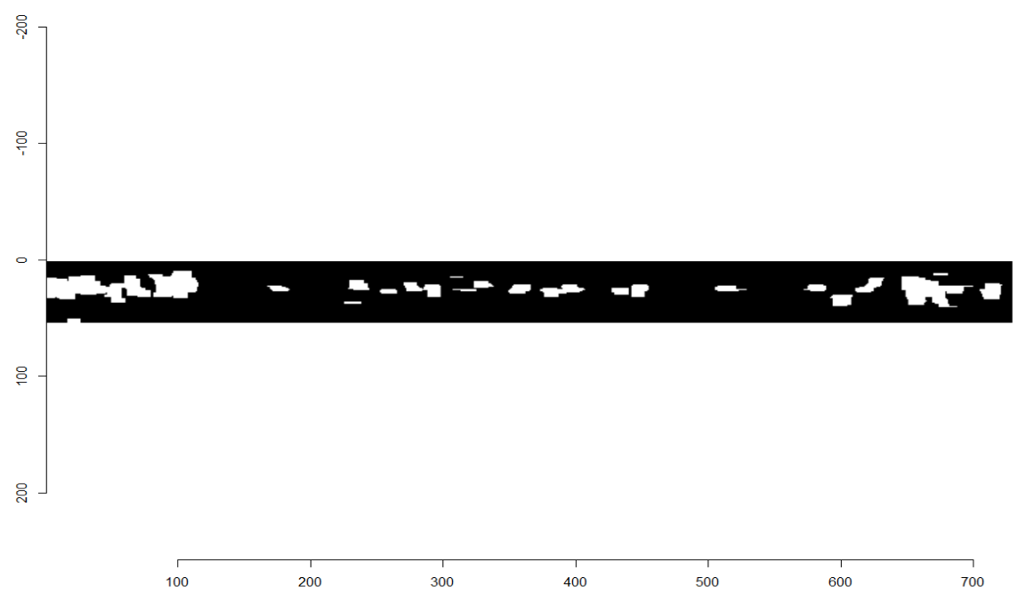
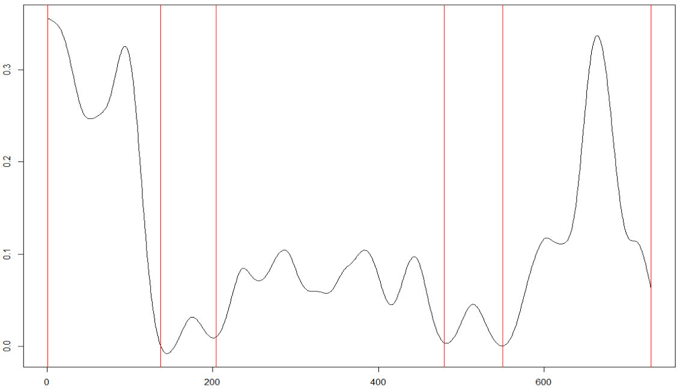
Finding Crop Chop Points
Using a smooth spline again.
Find points that fall below a certain threshold, then look in between the points to determine if it is a verified crop chunk.
This helps prevent random weeds or single crop growth from being considered a segment.

Slide 28
A Few Final Results

Slide 29
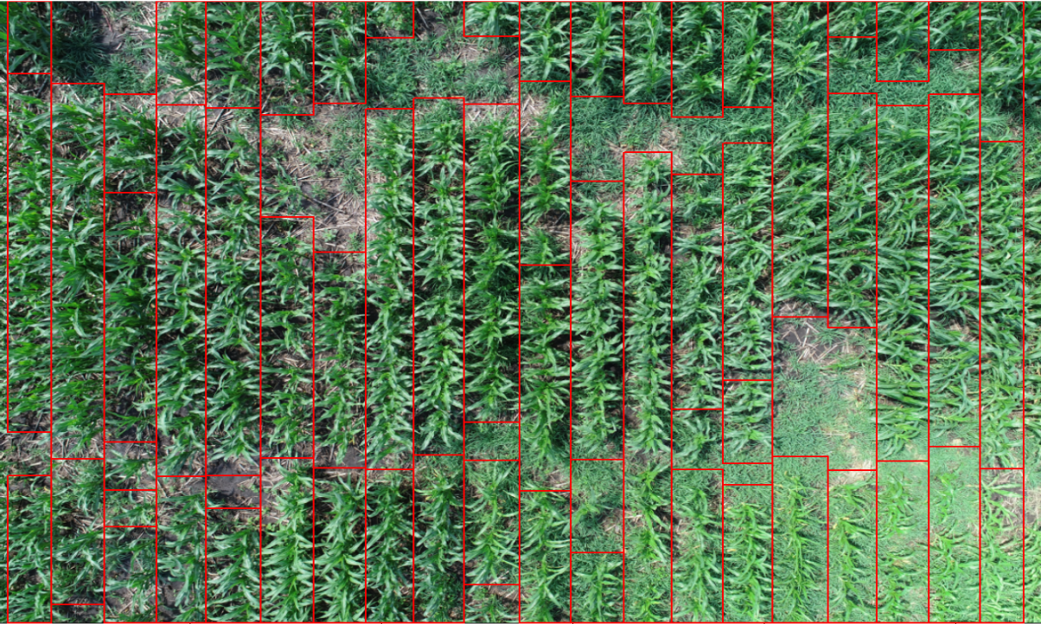

Slide 30
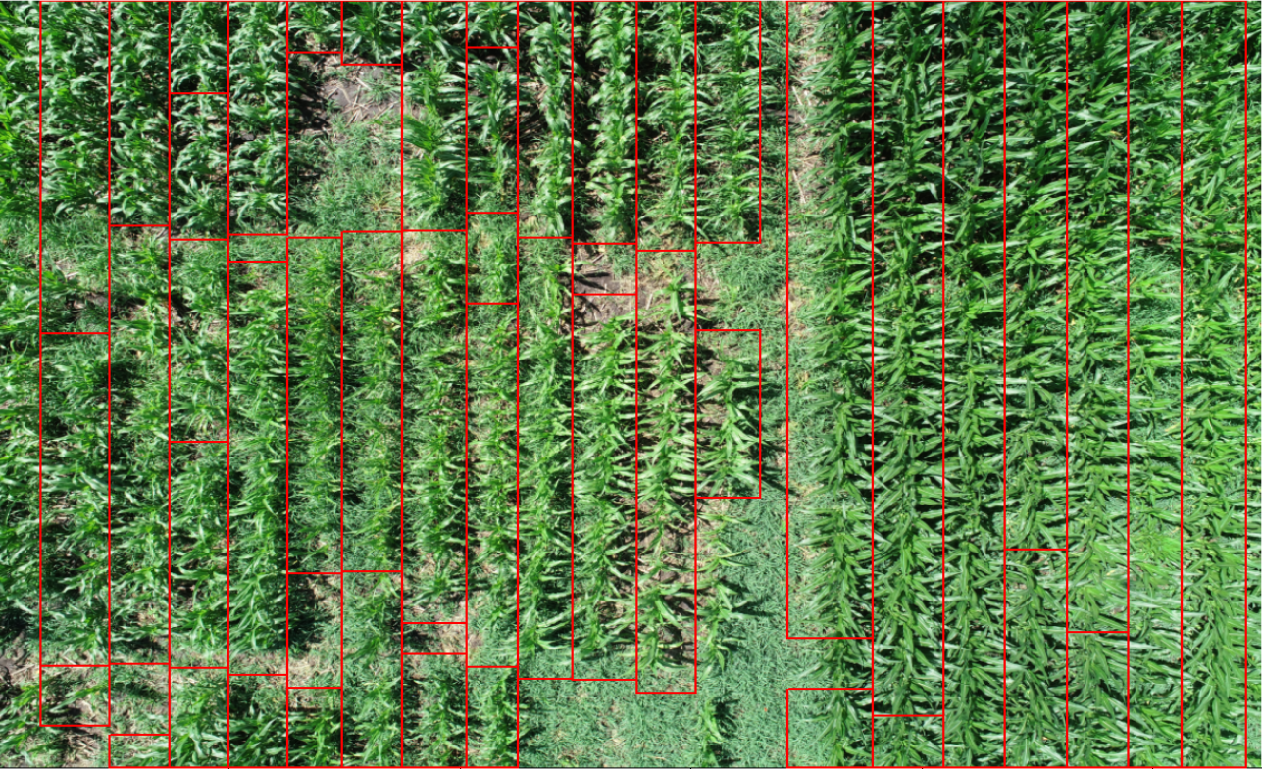

Slide 31
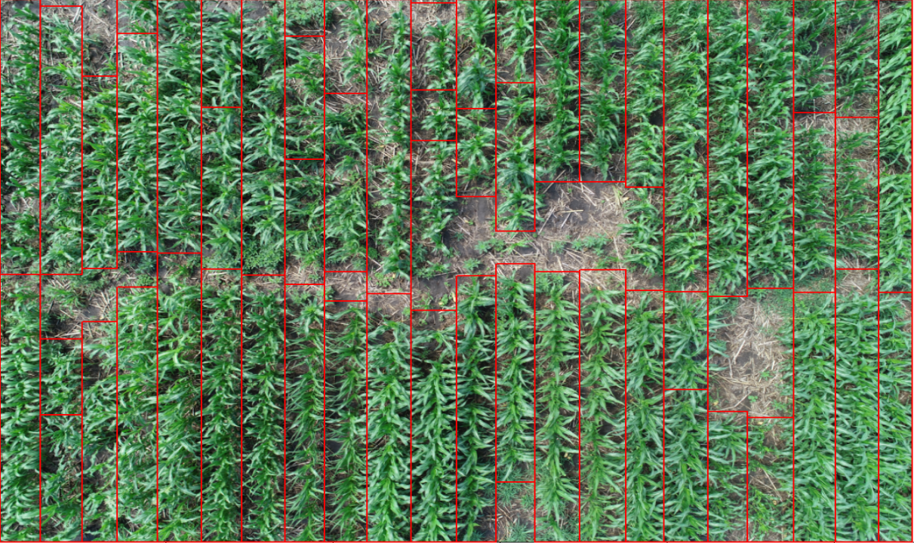

Slide 32
Thank you Q&A

